Slide 1
Pediatric Nephrology Review
Anke Banks
Anke.banks@ahs.ca
Jan. 23, 2020

Slide 2
Outline
Approach to the abnormal urinalysis
  Hematuria
    Macro
    Micro
  Proteinuria
Hypertension
Weird stuff
  Barrter’s
  Gitelmans
  Maybe RTAs

Slide 3
Approach to the Abnormal Urinalysis

Slide 4
Case 1
5 year old boy
  1 week history of swelling around his eyes
  One episode of brown coloured urine
  History of sore throat and ear ache about 2 weeks ago
The nursing assessment states:
  Temp 36.8 C
  HR 110
  RR 20
  BP 95/60

Slide 5
Hematuria

Slide 6
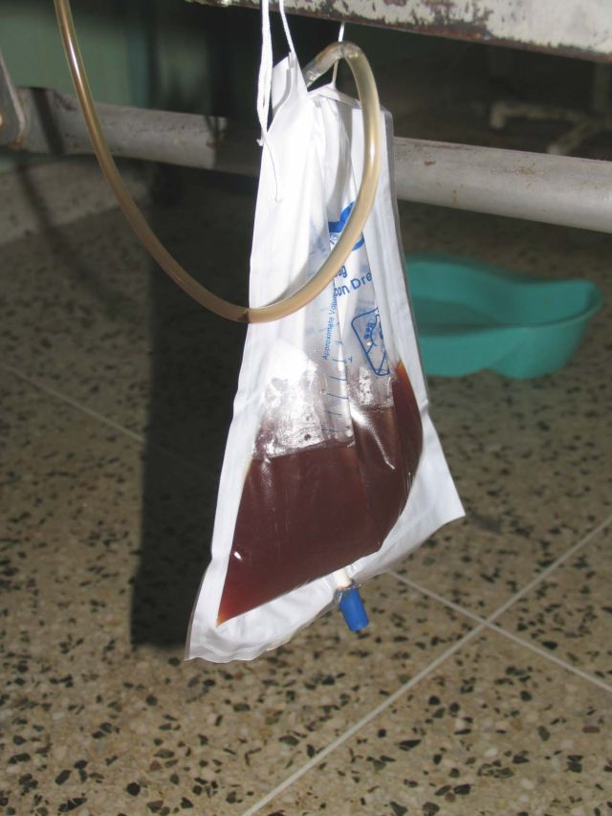
Gross vs microscopic
Gross
Can see with the naked eye
Does not necessarily reflect a large degree of blood loss
  As little as 1 mL of blood per liter of urine can induce a visible colour change

Slide 7
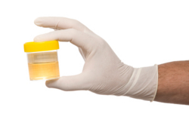
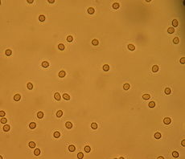
Gross vs Microscopic
Microscopic
≥5 red blood cells per high powered field (hpf) in a spun urine sediment

Slide 8
General Approach to Gross Hematuria
Is it blood or just red urine?
Are there red blood cells in the urine or just a heme-positive urinalysis?
Where is it coming from (glomerular vs. non-glomerular)?
No really, where is it coming from?

Slide 9
General Approach to Gross Hematuria
Is it blood or just red urine?
Are there red blood cells in the urine or just a heme-positive urinalysis?
Where is it coming from (glomerular vs. non-glomerular)?
No really, where is it coming from?

Slide 10
1. Is it blood or just red urine?
Urine can be red for many reasons other than blood
How can you answer the above question?
Need to do a urinalysis to be sure blood is present

Slide 11
1. Is it blood or just red urine?
Red urine
Heme-positive urinalysis
Heme-negative urinalysis

Slide 12
Urinalysis - 1
Urinalysis:
Appearance: clear
Colour: red
Specific gravity: 1.020 (reference range: 1.003-1.030)
pH: 7.0 (reference range 5.0-8.0)
Leukocyte esterase: negative
Nitrite: negative
Protein: negative (reference range: neg-0.15)
Glucose: normal
Ketones: negative
Blood: negative

Slide 13
Urinalysis - 1
Urinalysis:
Appearance: clear
Colour: red
Specific gravity: 1.020 (reference range: 1.003-1.030)
pH: 7.0 (reference range 5.0-8.0)
Leukocyte esterase: negative
Nitrite: negative
Protein: negative (reference range: neg-0.15)
Glucose: normal
Ketones: negative
Blood: negative

Slide 14
Causes of red urine
Heme negative on U/A
Meds
  Doxorubicin
  Chloroquine
  Ibuprofen
  Iron sorbitol
  Nitrofurantoin
  Rifampin
  Deferoxamine
  Phenolphthalien
  Phenazopyridine
Food dyes
  Beets
  Blackberries
  Food colouring
Metabolites
  Bile pigments
  Melanin
  Urates
  Porphyrin
  Methemoglobin

Slide 15
General Approach
Is it blood or just red urine?
Are there red blood cells in the urine or just a heme-positive urinalysis?
Where is it coming from (glomerular vs. non-glomerular)?
No really, where is it coming from?

Slide 16
General Approach
Is it blood or just red urine?
Are there red blood cells in the urine or just a heme-positive urinalysis?
Where is it coming from (glomerular vs. non-glomerular)?
No really, where is it coming from?

Slide 17
Urinalysis - 2
Urinalysis:
Appearance: clear
Colour: red
Specific gravity: 1.020 (reference range: 1.003-1.030)
pH: 7.0 (reference range 5.0-8.0)
Leukocyte esterase: negative
Nitrite: negative
Protein: negative (reference range: neg-0.15)
Glucose: normal
Ketones: negative
Blood: 250 (++++) Ery/uL
Urine Microscopy:
RBCs: 0-2 (reference range: 0-3 RBCs/hpf)
WBC: 0-2 (reference range: 0-8 WBCs/hpf)

Slide 18
Urinalysis - 2
Urinalysis:
Appearance: clear
Colour: red
Specific gravity: 1.020 (reference range: 1.003-1.030)
pH: 7.0 (reference range 5.0-8.0)
Leukocyte esterase: negative
Nitrite: negative
Protein: negative (reference range: neg-0.15)
Glucose: normal
Ketones: negative
Blood: 250 (++++) Ery/uL
Urine Microscopy:
RBCs: 0-2 (reference range: 0-5 RBCs/hpf)
WBC: 0-2 (reference range: 0-8 WBCs/hpf)

Slide 19
Question
What can cause a urinalysis to be “positive” for blood when no red blood cells are seen on microscopy?
Free hemoglobin
Myoglobin
High urine calcium
A and B only
All of the above

Slide 20
2. Are there RBC’s in the urine?
How does the urine dipstick work?
Hydrogen peroxide.
  This catalyzes a reaction between hemoglobin (or myoglobin) and a dye (chromogen tetramethylbenzidine)

Slide 21
2. Are there RBC’s in the urine?
Red urine
Heme-positive urinalysis
Heme-negative urinalysis
Red blood cells present
Red blood cells absent
Free hemoglobin
Myoglobin
Hemolysis
Rhabdomyolysis
é LDH
é bilirubin
é creatine kinase
é myoglobin

Slide 22
2. Are there RBC’s in the urine?
Urine centrifugation (sometimes reported)
  Cells are spun down
Sediment red or brown
  Blood!
Supernatant red or brown
  Not blood!

Slide 23
General Approach
Is it blood or just red urine?
Are there red blood cells in the urine or just a heme-positive urinalysis?
Where is it coming from (glomerular vs. non-glomerular)?
No really, where is it coming from?
Notes:
How can we differentiate glomerular from non-glomerular blood

Slide 24
Case 1 revisited
5 year old boy
  1 week history of swelling around his eyes
  One episode of brown coloured urine
  History of sore throat and ear ache about 2 weeks ago
The nursing assessment states:
  Temp 36.8 C, HR 110, RR 20, BP 95/60
U/A

Slide 25
Case 1 revisited
Urinalysis:
Appearance: clear
Colour: red
Specific gravity: 1.020 (reference range: 1.003-1.030)
pH: 7.0 (reference range 5.0-8.0)
Leukocyte esterase: negative
Nitrite: negative
Protein: 2 g/L (reference range: neg-0.15)
Glucose: normal
Ketones: negative
Blood: 250 (++++) Ery/uL
Urine Microscopy:
RBCs: >100(reference range: 0-3 RBCs/hpf)
WBC: 20-50 (reference range: 0-8 WBCs/hpf)
RBC casts present
Hyaline casts: 5-10 (reference range: 0-8 WBCs/hpf)

Slide 26
Case 1 revisited
Urinalysis:
Appearance: clear
Colour: red
Specific gravity: 1.020 (reference range: 1.003-1.030)
pH: 7.0 (reference range 5.0-8.0)
Leukocyte esterase: negative
Nitrite: negative
Protein: 2 g/L (reference range: neg-0.15)
Glucose: normal
Ketones: negative
Blood: 250 (++++) Ery/uL
Urine Microscopy:
RBCs: >100 (reference range: 0-3 RBCs/hpf)
WBC: 20-50 (reference range: 0-8 WBCs/hpf)
RBC casts present
Hyaline casts: 5-10 (reference range: 0-8 WBCs/hpf)

Slide 27
3. Where is it coming from?
Divide into glomerular and non-glomerular
What are some of the distinguishing features of these two types of hematuria?

Slide 28
3. Where is it coming from?
 | Glomerular | Non-glomerular
Urine appearance
Urinalysis
Microscopy

Slide 29
3. Where is it coming from?
 | Glomerular | Non-glomerular
Urine appearance | Tea or cola coloured Clots not present | Bright red or pink blood May see clots
Urinalysis | Protein >2+ | Protein <2+
Microscopy | Dysmorphic RBCs RBC casts | Normal RBC morphology No casts

Slide 30
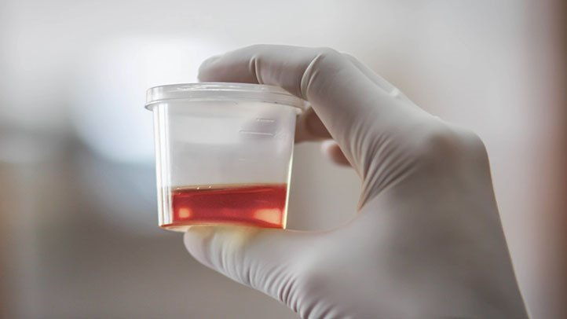
Non-glomerular blood
https://www.everydayhealth.com/urine/what-causes-blood-urine-hematuria/

Slide 31
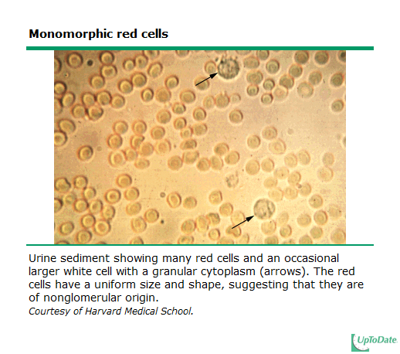
Non-glomerular blood
Notes:
RBC’s in urine appear as refractile discs

Slide 32
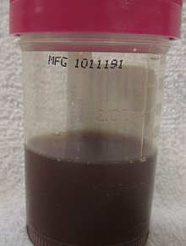
Glomerular bleeding
Notes:
Tea colored urine

Slide 33
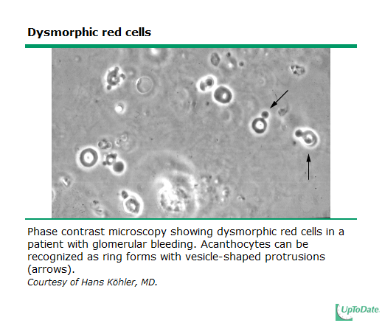
Glomerular bleeding
Notes:
Dysmorphic RBCs can take several forms
- Dysmorphic = irregular outlines
- Acanthocytes – looks like a donut with a bleb (2 blebs = Mickey Mouse)
- Phase contrast: >5% acanthos or >30% dysmorphic cells - highly suggestive of glomerular hematuria

Slide 34
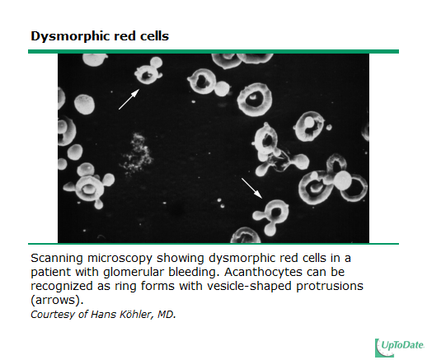
Glomerular bleeding

Slide 35
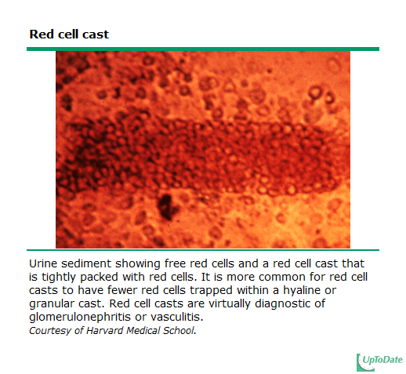
Glomerular bleeding

Slide 36
Case 1 revisited
Urinalysis:
Appearance: clear
Colour: red
Specific gravity: 1.020 (reference range: 1.003-1.030)
pH: 7.0 (reference range 5.0-8.0)
Leukocyte esterase: negative
Nitrite: negative
Protein: 2 g/L (reference range: neg-0.15)
Glucose: normal
Ketones: negative
Blood: 250 (++++) Ery/uL
Urine Microscopy:
RBCs: >100 (reference range: 0-3 RBCs/hpf)
WBC: 20-50 (reference range: 0-8 WBCs/hpf)
RBC casts present
Hyaline casts: 5-10 (reference range: 0-8 WBCs/hpf)
IMPRESSION: likely glomerular source

Slide 37
General Approach
Is it blood or just red urine?
Are there red blood cells in the urine or just a heme-positive urinalysis?
Where is it coming from (glomerular vs. non-glomerular)?
No really, where is it coming from?

Slide 38
Etiology of gross hematuria
Most common causes of gross hematuria in children
Depends on the setting
How about in those presenting to ER?
  UTI
  Irritation of the meatus or perineum
  Trauma
Ingelfinger JR, et al, Pediatrics. 1977;59(4):557
Patel HP, Bissler JJ, Pediatr Clin North Am. 2001; 48:1519
Notes:
- Overall, the majority of patients who present with gross hematuria have an easily recognizable and apparent cause

Slide 39
Etiology
Less common causes of gross hematuria
  Acute nephritis
    Post-infectious glomerulonephritis
    IgA nephropathy
  Nephrolithiasis
  Coagulopathy
  Sickle cell disease
  Drug-induced hemorrhagic cystitis
  Malignancy (Wilms or rarely transitional cell carcinoma)
  Hypercalciuria
  Post-micturition urethral bleeding
  No cause
Ingelfinger JR, et al, Pediatrics. 1977;59(4):557
Patel HP, Bissler JJ, Pediatr Clin North Am. 2001; 48:1519
Notes:
Post-micturition urethral bleeding, a benign condition, may also be seen in infant boys with resolution by one year of age in most cases
Relative frequency depends on the setting
ER: UTI, perineal irriation, trauma, acute nephrtitis, coagulopathy and stone
Peds Urologist: urethral irritation or trauma (15 percent), UTI (14 percent), underlying congenital anomalies such as vesicoureteral reflux (VUR), posterior urethral valves (PUV), or ureteropelvic junction obstruction (UPJO) (13 percent), nephrolithiasis (5 percent), and malignancy (1 percent)
Ped Neph: glomerular (29%) – IgA then Alports, nonglomeruar – hypercalciuria, urethtral irritation, trauma

Slide 40
Differential for hematuria
Extra-Glomerular
Glomerular
Isolated renal disease
Systemic disease
Upper urinary tract
Lower urinary tract
PIGN – Post-infectious
IgA nephropathy
Alport Syndrome
Thin BM disease
MPGN/FSGS
Anti-GBM disease
Inflammation
Infection
Urolithiasis
Trauma
Coagulopathy
Heavy exercise
Munchausen/
Munch by proxy
HSP nephritis
Hemolytic uremic syndrome
SLE nephritis
ANCA vasculitis
Tubulo-interstitial
Vascular
Crystalluria
Hemoglobinopathy
Anatomic

Slide 41
Differential for hematuria
Extra-Glomerular
Glomerular
Isolated renal disease
Systemic disease
Upper urinary tract
Lower urinary tract
PIGN – Post-infectious
IgA nephropathy
Alport Syndrome
Thin BM disease
MPGN/FSGS
Anti-GBM disease
Inflammation
Infection
Urolithiasis
Trauma
Coagulopathy
Heavy exercise
Munchausen/
Munch by proxy
HSP nephritis
Hemolytic uremic syndrome
SLE nephritis
ANCA vasculitis
Tubulo-interstitial
Vascular
Crystalluria
Hemoglobinopathy
Anatomic

Slide 42
Differential for hematuria
Upper urinary tract
Tubulo-interstitial
Hemoglobin-opathy
Vascular
Anatomic
Crystalluria
Pyelonephritis
Acute interstitial nephritis
Acute tubular necrosis
Arterial/venous thrombosis
Malformations
Aneurysm
Nutcracker syndrome
Cystic kidney disease
Tumor
Trauma
Calcium
Oxalate
Uric acid
Sickle cell disease/trait

Slide 43
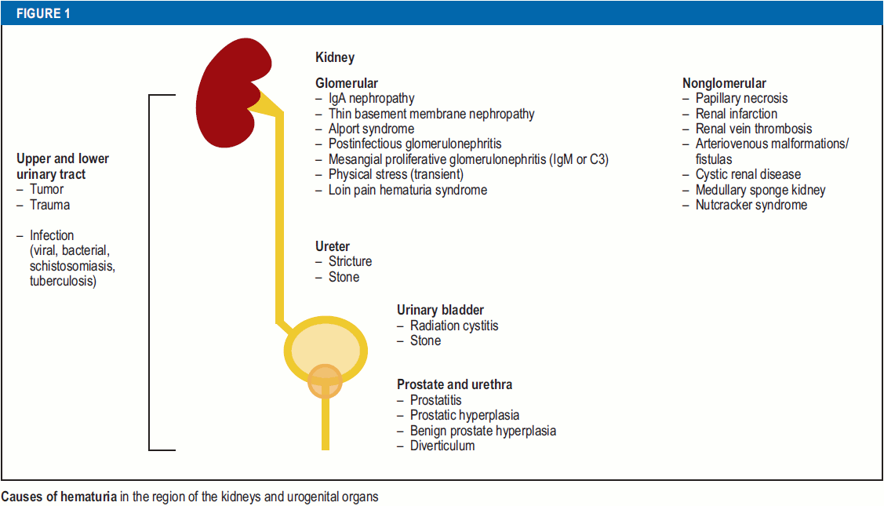
Bolenz, C; Schröppel, B; Eisenhardt, A; Schmitz-Dräger, B J; Grimm, M
The Investigation of Hematuria
Dtsch Arztebl Int 2018; 115(48): 801-7; DOI: 10.3238/arztebl.2018.0801

Slide 44
Gross hematuria - history
Usually there are clues!
Recent heavy exercise or trauma
Incontinence, dysuria, frequency, or urgency
Loin to groin (or sometimes just abdo) pain
Flank pain without radiation but with fever, dysuria, and frequency
Timing of hematuria
  Initial
  Continuous
  Terminal
Colour of urine
History of illness
  Recent vs concurrent
Past medical history of pre-disposing conditions
  Sickle cell, coagulopathies
Medication history
  Cyclophosphamide
  NSAIDs eosinophilic cystitis (nonsteroidal anti-inflammatory drug or antihistamines) [7-9], or interstitial nephritis
Ingelfinger JR, et al, Pediatrics. 1977;59(4):557
UpToDate, Accessed 2020
Notes:
Flank pain - left renal vein compression between the aorta and proximal superior mesenteric artery, referred to as "nutcracker syndrome,“Nutcracker syndrome is detected by Doppler ultrasonographic assessment of left renal vein diameter and peak velocity or computed tomography
Timing
initial hematuria (onset of urination) usually suggests urethral bleeding;
continuous bleeding throughout urination may occur from bleeding in the bladder, ureter or kidneys
terminal bleeding (at the end of urination) is indicative of bladder disease.
MEDS
hemorrhagic cystitis (such as cyclophosphamide),
eosinophilic cystitis (nonsteroidal anti-inflammatory drug or antihistamines)
interstitial nephritis

Slide 45
Gross hematuria - PE
More clues!
BP – high vs low?
Edema
Rash
Purpura
Genitalia erosions
Abdo mass
Ingelfinger JR, et al, Pediatrics. 1977;59(4):557
UpToDate, Accessed 2020
Notes:
Measurement of blood pressure (BP) – Elevated BP may be seen in patients with glomerular disease and low BP in patients with significant bleeding due to trauma.
Assessment for edema and recent weight gain - glomerular disease
rash, systemic lupus erythematous [SLE] or
Purpura - IgA vasculitis [Henoch-Schönlein purpura])
genitals (looking for penile urethral meatal erosion or female introitus pathology).
abdominal discomfort or masses (eg, Wilms tumor).

Slide 46
Next steps

Slide 47
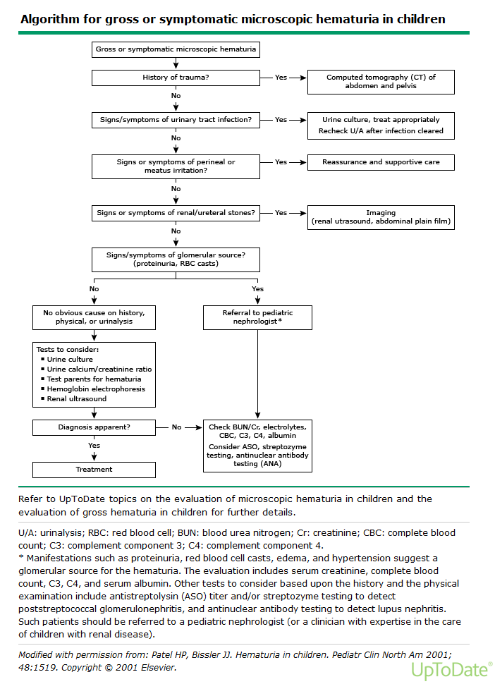

Slide 48
Case 1 revisited
5 year old boy
  1 week history of swelling around his eyes
  One episode of brown coloured urine
  History of sore throat and ear ache about 2 weeks ago
The nursing assessment states:
  Temp 36.8 C, HR 110, RR 20, BP 95/60
U/A – likely glomerular source

Slide 49
Glomerular
Isolated Renal Disease
Systemic disease
PIGN – Post-infectious
IgA nephropathy
Alport Syndrome
Thin BM disease
MPGN/FSGS
Anti-GBM disease
Henoch Schonlein purpura nephritis
Hemolytic uremic syndrome
Systemic lupus erythematous nephritis
ANCA vasculitis
  Granulomatosis with polyangiitis (GPA)
  Microscopic polyangiitis
Notes:
Determined this is likely a glomerular source.
Now we want to know if it renal-limited or if it is systemic

Slide 50
Case 1 revisited
What do you want to know on history?
What are you looking for on physical exam?

Slide 51
Key history for glomerular hematuria
HPI:
  Recent illness
  Concurrent illness
ROS
  HEENT: hearing loss,
  Resp: Cough, hemoptysis
  GI: abdo pain, diarrhea (?bloody?)
  MSK: arthralgia
  Derm: rash, purpura
Notes:
Recent illness
Pharyngitis or impetigo 2-3 weeks ago

Slide 52
Key history for glomerular hematuria
PMHx:
  Hematuria (previous episodes)
  Recurrent “UTIs” that are culture negative
Family Hx
  Hematuria
  Hearing loss
  Prominent history of renal failure in males

Slide 53
Key PE for glomerular hematuria
Measure BP
Edema (or recent weight gain)
HEENT: oral ulcers, retinal changes
Resp: wheeze, poor air entry
Abdo – abdo discomfort
MSK: edema, heat, pain
Derm – purpura, rash

Slide 54
Case 1 revisited
5 year old boy
  1 week history of swelling around his eyes
  1 episode of brown coloured urine
  History of sore throat and ear ache about 2 weeks ago
The nursing assessment states:
  Temp 36.8 C, HR 110, RR 20, BP 95/60
U/A – appears glomerular
Additional hx:
  No other episodes of hematuria, no family members with hematuria, ROS negative.
  PE:
    Mild peri-orbital edema otherwise normal exam

Slide 55
Glomerulonephritis
Inflammation of the nephrons
Key features of GNs?
PHAROH
  Proteinuria – usually non-nephrotic
  Hematuria
  Azotemia
  RBC casts
  Oliguria
  Hypertension

Slide 56
Nephritic clinical presentation in children
Acute GN
  Post-infectious GN
  HSP nephritis
  Chronic GNs: IgA, MPGN, lupus
Rapidly progressive GN
  Primary GN (isolated renal disease): IgA, MPGN
  Secondary GN: ANCA-associated, lupus, PIGN, HSP
Recurrent macroscopic hematuria
  IgA, Alport
Chronic glomerulonephritis
  Primary GN: MPGN, IgA, anti-GBM disease
  Secondary GN: lupus nephritis, granulomatosis with polyangiitis
Uptodate, GN in children, accessed Sept. 2016)
Notes:
Acute GN: sudden onset of hematuria (either gross or microscopic) with proteinuria, decreased glomerular filtration rate, and retention of sodium and water, which usually results in an elevated blood pressure and edema.
RPGN: features of acute GN with progressive loss of renal function over a short period of time (days, weeks, or months). It is characterized morphologically by extensive crescent formation
Chronic: presentation depends on stage – may appear like acute nephritic syndrome, or if dx in late stage, may have CKD sx (HTN, renal impairment and proteiuria)

Slide 57
Investigations for glomerular hematuria
For everyone
  U/A, Urine microscopy
    Glomerular vs non glomerular

Slide 58
Investigations for glomerular hematuria
Symptomatic gross hematuria
  S/Sx of glomerular disease
    Standard labs: CBC, lytes, Cr, urea, albumin
    Special tests: C3, C4, ASOT, ANA
    Based on hx: ANCAs, Hep B/C screen, anti-GBM
    Immunoglobulins???
    Imaging: ultrasound
Notes:
Immunoglobulins – 20-50% of patients with IgA will have elevated serum IgA

Slide 59
Investigations for glomerular hematuria
Asymptomatic gross hematuria
  Urine: U/A, Urine Ca/Cr, U Cx
  Standard labs: creatinine, C3
  Imaging: US (r/o calculus)
  Family testing – for hematuria (possible TBM or Alports disease)
Notes:
Etiologies for gross hematuria included the following (retrospective review of 228 pts):
No identifiable cause — 36%
Hypercalciuria — 22%
IgA nephropathy —16%
Post-streptococcal glomerulonephritis — 7%
Other glomerulopathies including thin basement membrane disease — 2%
Congenital anomalies (eg, ureteropelvic junction obstruction or renal dysplasia) — 2%
Sickle cell trait — 1%

Slide 60
Case 1 revisited
5 year old boy
  1 week history of swelling around his eyes
  One episode of brown coloured urine
  History of sore throat and ear ache about 2 weeks ago
The nursing assessment states:
  Temp 36.8 C, HR 110, RR 20, BP 95/60
U/A – likely glomerular source
Labs
  Creatinine and urea - slightly increased
  Lytes normal
  C3 is low, C4 is normal
  Throat swab grows Group A strep

Slide 61
Post-infectious glomerulonephritis
AKA post-streptococcal GN
Epidemiology
  The most common cause of acute GN in children
  Age: usually > 3 years (most commonly 5-12 y)
  Sporadic or epidemic of group A streptococcal infection
Eison et al., Ped Neph (2011) 26:165
Uptodate, PSGN, accessed Sept. 2016)
Notes:
- decline in PSGN in developed countries thought secondary to better hygiene and thus decrease in streptococcal pyoderma and decreased prevalence of skin infection serotypes
- Nephritogenic antigen

Slide 62
Post-infectious glomerulonephritis
Pathophysiology
  Certain group A strep strains are nephritogenic
  Infectious agents (staph or strep)produce nephritogenic antigens that may be deposited in the glomerulus
  The humoral response activates the alternative complement pathway
  Complement activation leads to
    Generation of chemotactic and chemokinetic peptides (C3a, C5a, C3b) that attract WBC to the site of injury
    Formation of membrane attack complex (C5b-C9) which may cause direct injury to glomerular cells
Eison et al., Ped Neph (2011) 26:165
Uptodate, PSGN, accessed Sept. 2016)
Notes:
- decline in PSGN in developed countries thought secondary to better hygiene and thus decrease in streptococcal pyoderma and decreased prevalence of skin infection serotypes
- Nephritogenic antigen

Slide 63
Post-infectious glomerulonephritis
Clinical presentation
  3 phases of disease
    Latent
      From time of strep infection to acute phase
      Throat infection: 1-3 weeks
      Skin infection: 3-6 weeks
    Acute
      Edema
        From fluid and sodium retention
      Hematuria
        Tea-colored
      Hypertension
        From salt and water retention
    Recovery
Notes:
Edema – fluid and sodium retention

Slide 64
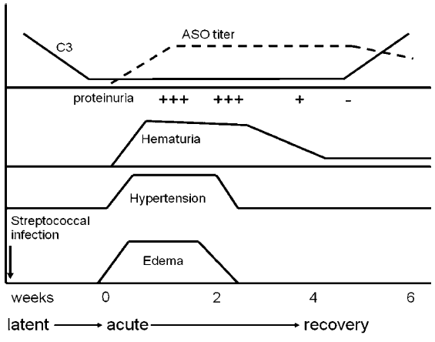
Post-infectious glomerulonephritis
2 weeks
Eison et al, Ped Neph (2011) 26:165
Notes:
Latent: preceding streptococcal infection usually 7-14 d before.
May vary with type of infection: Throat : 1-3, skin 3-6 weeks post
Acute: hematuria universally present, protein present, nephrotic syndrome is rare (2-4%)
Hypertension – from the retention of Na and water
Recovery:

Slide 65
Post-infectious glomerulonephritis
Labs
  Renal function – ↑creatinine
  U/A – hematuria ± RBC casts, proteinuria, pyuria
  Urine protein to creatinine ratio
  Complement
    Decrease in C3 in 90% of people
    Should return to normal 4-8 weeks from nephritis presentation
  Throat or skin cx
  Serology
    Anti-streptolysin O (ASO)
    Streptozyme (measures 5 different streptococcal antibodies)
      Positive

Slide 66
Post-infectious glomerulonephritis
Management
  Typically supportive
  Treat hypertension
    Loop diuretics
    Sodium and water restriction
    Occasionally calcium channel blocker
  Rarely – dialysis
  Bx: course deviates from typical PIGN
  Throat swab
Follow-up
  C3 should recover
  Hematuria – resolves within 3-6 months
  Proteinuria – decrease slowly (can still see elevation up to 10 years post-illness)

Slide 67
Microscopic Hematuria

Slide 68
Case 2
14 yo male, previously well, presents to the emergency room
3 d hx URTI
2 d hx of puffiness to his eyes

Slide 69
Case 2
Urinalysis:
Appearance: clear
Colour: yellow
Specific gravity: 1.020 (reference range: 1.003-1.030)
pH: 7.0 (reference range 5.0-8.0)
Leukocyte esterase: negative
Nitrite: negative
Protein: 0.3 g/L (reference range: neg-0.15)
Glucose: normal
Ketones: negative
Blood: 250 (++++) Ery/uL
Urine Microscopy:
RBCs: >30 (reference range: 0-3 RBCs/hpf)
WBC: 0-2 (reference range: 0-8 WBCs/hpf)

Slide 70
Microscopic hematuria
Is it persistent?
Where is it coming from (glomerular vs. non-glomerular)?
No really, where is it coming from?

Slide 71
Microscopic hematuria
Is it persistent?
Where is it coming from (glomerular vs. non-glomerular)?
No really, where is it coming from?

Slide 72
1. Is it persistent?
If patient is Asx with isolated micro hematuria
  Repeat U/A weekly x 2
Persistent hematuria
  Positive repeat test after 6 mo

Slide 73
1. Is it persistent?
Most common causes of persistent microscopic hematuria (not necessarily isolated)
  Glomerulopathies – IgA, Alport, TBM, PIGN
  Hypercalciuria
  Nutcracker syndrome
Notes:
Nutcracker – Left renal vein compression btw aorta and prox SMA
- May also see postural proteinuria with this.
Dx – Doppler renal US assessment of left renal vein diameter and peak velocity

Slide 74
Microscopic hematuria
Is it persistent?
Where is it coming from (glomerular vs. non-glomerular)?
No really, where is it coming from?

Slide 75
2. Where is it coming from?
Is it isolated or is there accompanying proteinuria or other findings?
Isolated
  Can keep following with U/As q3-6 mo
  Consider additional tests if still present at 1 y
    Urine Calcium to Creatinine ratio (R/O hypercalciuria)
    Test parents (thin basement membrane or hereditary nephritis)
    Consider US (R/O nutcracker)

Slide 76
2. Where is it coming from?
Is it isolated or is there accompanying proteinuria or other findings?
Proteinuria present
    Quantify proteinuria
    Measure Cr
    Special tests (C3 etc) as noted in macro hematuria
  If sx are also present, use these to further direct investigations as in macro hematuria

Slide 77
Case 2
Urinalysis:
Appearance: clear
Colour: yellow
Specific gravity: 1.020 (reference range: 1.003-1.030)
pH: 7.0 (reference range 5.0-8.0)
Leukocyte esterase: negative
Nitrite: negative
Protein: 3 g/L (reference range: neg-0.15)
Glucose: normal
Ketones: negative
Blood: 250 (++++) Ery/uL
Urine Microscopy:
RBCs: >30 (reference range: 0-3 RBCs/hpf)
WBC: 0-2 (reference range: 0-8 WBCs/hpf)
IMPRESSION: likely glomerular source

Slide 78
Microscopic hematuria
Is it persistent?
Where is it coming from (glomerular vs. non-glomerular)?
No really, where is it coming from?

Slide 79
Back to the case…
Urinary hx
  Denies dysuria, urgency, frequency, supra-pubic pain
Recent URTI over last 2 d
Denies all else

Slide 80
Differential for hematuria
Extra-Glomerular
Glomerular
Isolated renal disease
Systemic disease
Upper urinary tract
Lower urinary tract
PIGN – Post-infectious
IgA nephropathy
Alport Syndrome
Thin BM disease
MPGN/FSGS
Anti-GBM disease
Inflammation
Infection
Urolithiasis
Trauma
Coagulopathy
Heavy exercise
Munchausen/
Munch by proxy
HSP nephritis
Hemolytic uremic syndrome
SLE nephritis
ANCA vasculitis
Tubulo-interstitial
Vascular
Crystalluria
Hemoglobinopathy
Anatomic

Slide 81
Back to the case…
PMHx:
  Hematuria happened once before a couple of months ago when he had an URTI (forgot to tell anyone)
Meds: none
Allx: none, IUTD
SocHx: denies ingestions
FamHx:
  No one with hematuria, hearing loss, kidney stones

Slide 82
Back to the case…
PE
  Normotensive
  Mild periorbital edema, normal exam

Slide 83
Back to the case…
What do you want to order?

Slide 84
Differential for hematuria
Extra-Glomerular
Glomerular
Isolated renal disease
Systemic disease
Upper urinary tract
Lower urinary tract
PIGN – Post-infectious
IgA nephropathy
Alport Syndrome
Thin BM disease
MPGN/FSGS
Anti-GBM disease
Inflammation
Infection
Urolithiasis
Trauma
Coagulopathy
Heavy exercise
Munchausen/
Munch by proxy
HSP nephritis
Hemolytic uremic syndrome
SLE nephritis
ANCA vasculitis
Tubulo-interstitial
Vascular
Crystalluria
Hemoglobinopathy
Anatomic

Slide 85
Back to the case…
Ucx: negative
Urine protein:creatinine: 306 mg/mmol (normal <25, nephrotic range >250)
Urine Ca:creatinine: 0.4 (normal <0.6 mmol/mmol)

Slide 86
Back to the case…
CBC – slightly elevated WBC and neuts
Lytes – N
Albumin 29 (low)
Cr 84, urea 4.9 (normal)
ESR 66 and CRP 117

Slide 87
Back to the case…
Special tests
  C3, C4, ASOT, ANCAs, anti-GBM – normal
  Immunoglobulins - normal

Slide 88
Back to the case…
US kidneys
  Enlarged kidneys, increased parenchymal echogenicity
  No hydronephrosis or hydroureter
  Normal doppler exam
Notes:
Broad differential of enlarged echogenic kidneys
Acute GN (enlarged b/c edema)
ARPKD
AIN

Slide 89
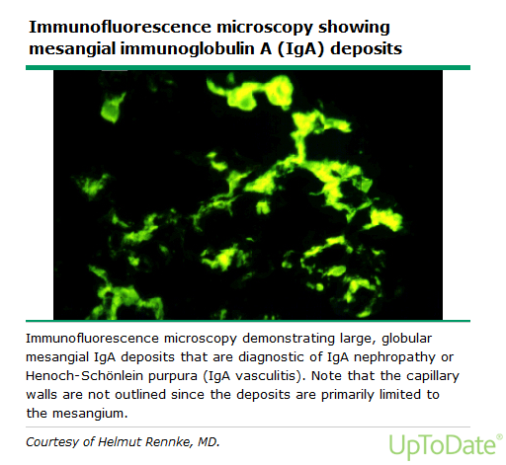
Back to the case…
Biopsy
  Acute tubular injury
  IgA nephropathy (IgA mesangial staining)
Notes:
Dx of IgA nephopathy – made by Bx – see mesangial IgA deposits on immunofluorescence microscopy
- May be alone or with IgA and IgG

Slide 90
IgA Nephropathy
2:1 Males : Females
Most prevalent GN worldwide
  Japan, France, Italy and Australia: 18-40% of all GNs
  US, UK - 2-10%
Peak incidence in 2nd and 3rd decade of life

Slide 91
IgA Nephropathy
Typical presentation
  Macroscopic hematuria following an URTI by 1-2 days
Other presentations
  30-40%
    Asx microscopic hematuria ± proteinuria
  <10%
    Nephrotic syndrome
    Mixed nephrotic/nephritic
    Rapidly progressive glomerulonephritis
      Acute nephritis (hematuria, proteinuria, renal insufficiency, HTN)
Notes:
- Approximately 40 to 50 percent present with one or recurrent episodes of gross (visible) hematuria, often accompanying an upper respiratory infection.

Slide 92
IgA Nephropathy
Labs: usually normal
  Normal complement
  20-50% will have elevated serum IgA
Diagnosis
  Can only be made with renal biopsy
    See mesangial IgA deposits

Slide 93
IgA Nephropathy
Prognosis
  20% - ESRD in 10 y
  20% - ESRD in 25 y
  60% - no progression
Worse prognosis
  Older age
  Hypertension
  Proteinuria (>1g in 24 h urine)
  Persistent microscopic hematuria
Better prognosis
  Recurrent macroscopic hematuria

Slide 94
IgA Nephropathy
Treatment
  Controversial
  Some RCTs show benefits from prednisone
    Decrease proteinuria
    Slow progression of renal failure
  RAS blockade (ACEI or ARB)
  Probably little benefit from fish oils
Overall:
  Consider steroids if nephrotic syndrome or renal insufficiency

Slide 95
A few others…
Thin Basement Membrane Nephropathy
Hereditary Nephritis (aka Alport Syndrome)

Slide 96
Hereditary nephritis
(aka Alport syndrome)
Pathology
  Mutation in gene encoding one of the 6 alpha chains that comprise type 4 collagen (COL4)
Genetics
  80% of mutations are X-linked COL4A5
    Encodes alpha5 chain of type IV collagen
    Females have variable penetrance (depends on type of mutation and degrees of lyonization of the X chromo)
  Other forms include
    AR – 15% (early onset renal failure in males and females)
    AD – 5% (renal failure of varying severity)

Slide 97
Hereditary nephritis
(aka Alport syndrome)
Clinical
  Kidneys
    Persistent microscopic hematuria
    Proteinuria (late childhood/earlyadolescence)
    Renal failure (50% by age 25 y)
    Interstitial nephritis
    Macroscopic hematuria (with illness in some pts)
    Hypertension (usually in teens)
  ENT
    SNHL in 50% by age 15y
  Ophtho
    Lenticonus of anterior lens capsule
    Retinopathy
Diagnosis
  - biopsy
Notes:
_ persistent micro hematuria – in all males starting at birth, in most (95%) of females
Proteinuria is secondary to deterioiration of GBM
Renal failure occurs secondary to interstitial nephritis then renal fibrosis

Slide 98
Thin Basement Membrane Nephropathy
AKA Benign Familial Hematuria
Pathology:
  Defects in COL4A3 or COL4A4
Epidemiology
  5-9% of general population (i.e. common!)
Clinical Presentations
  Microscopic hematuria
    persistent or intermittent
    Asymptomatic (usually incidentally discovered)
  Macroscopic hematuria
    May occur with URTI
  Usually normal BP and no proteinuria

Slide 99
Thin Basement Membrane Nephropathy
Diagnosis
  Usually clinical based on features of isolated micro hematuria with benign course
  Definitive = renal biopsy
Course
  Usually benign
  Some – slowly progressive renal failure via glomerular injury
    Increased risk with
      famhx of renal failure
      Proteinuria

Slide 100
Isolated and persistent glomerular hematuria
Feature | TBM disease | IgA | Alports
Gross hematuria | Uncommon (<10%) | Episodic, gross hematuria is common | May have episodic gross hematuria with illness
Family hx of hematuria | Yes (AD inheritance, 50% of first degree relatives will have) | Rare (case reports) | Yes (X-linked inheritance)
Family hx of renal failure | No | Rare | Yes
Other features |  |  | Fam Hx of deafness, ocular defects (especially x-linked disease)

Slide 101
Summary - hematuria
Approach to pediatric gross hematuria
  Is it blood or just red urine?
  Are there red blood cells in the urine or just a heme-positive urinalysis?
  Where is it coming from (glomerular vs. non-glomerular)?
  No really, where is it coming from?
Approach to pediatric microscopic hematuria
  Is it persistent?
  Where is it coming from (glomerular vs. non-glomerular)?
  No really, where is it coming from?
PIGN
  Common
  Presents after skin or throat strep infection with hematuria, hypertension, edema, low C3 and positive streptozyme
  Need to measure a follow-up C3 at 6 weeks post-illness to ensure that this is PIGN and not another etiology such as MPGN or shunt nephritis

Slide 102
Proteinuria

Slide 103
Case 3
3 year old male, previously well.
Mom notes that he had a cold 2 weeks ago and was prescribed amoxil.
Developed swelling around his eyes about 5 days after starting the amoxil. The antibiotic was stopped because of this “allergic reaction” and an antihistamine was prescribed
Swelling around eyes has not improved and now the child has edema to his abdomen
Nursing assessment: HR 80, RR 18, BP: 90/60

Slide 104

Periorbital edema
Infokid.org
(http://www.infokid.org.uk/nephrotic-syndrome-frequently-relapsing)

Slide 105
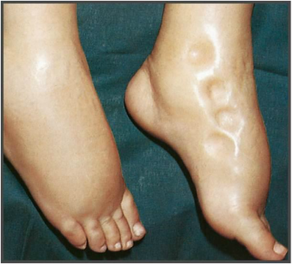
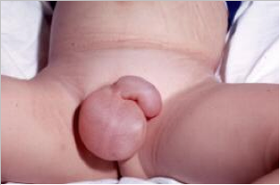
Pitting edema
Scrotal edema
http://www.medicalzone.net/differential-diagnosis-of-bilateral-pitting-ankle-edema.html
http://www.myhealth.gov.my/en/nephrotic-syndrome-2/

Slide 106
Case 3
Triage nurse sent a urine while the child was waiting.
Urinalysis:
Appearance: clear
Colour: yellow
Specific gravity: 1.015 (reference range: 1.003-1.030)
pH: 7.0 (reference range 5.0-8.0)
Leukocyte esterase: negative
Nitrite: negative
Protein: >3 (++++) g/L (reference range: neg-0.15)
Glucose: normal
Ketones: negative
Blood: negative Ery/uL
Urine Microscopy:
RBCs: 0-2 (reference range: 0-3 RBCs/hpf)
WBC: 0-2 (reference range: 0-8 WBCs/hpf)
Hyaline casts: 5-10 (reference range: 0-8 WBCs/hpf)

Slide 107
Outline
Measuring proteinuria
Normal protein excretion
Abnormal protein excretion
Approach

Slide 108
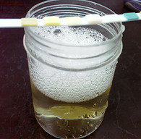
Measuring Proteinuria
www.nephcure.org

Slide 109
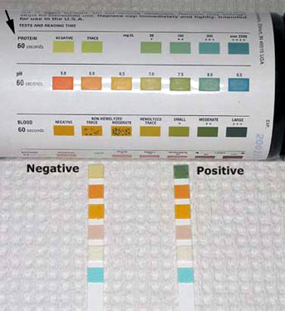
Measuring proteinuria
Urinalysis
  Detects albumin concentration
  Reported as
    g/L (neg to >3 g/L)
    + (neg to 4+)
www.vetbook.org
Notes:
Albumin is the major constituent of urinary proteins, but it is not the only urinary protein
Any problems with reporting a concentration?
What if urine was very dilute? (i.e. From poor concentrating ability)

Slide 110
Measuring proteinuria
Problems with a U/A
  False positives
    Alkaline urine
    Radiocontrast
    Antiseptic (chlorhexidine)
    Gross hematuria
    Dipstick left in urine too long/delay in reading
  May underestimate protein amount in dilute urine

Slide 111
Problem with the u/a
Protein: 2 g/L
Protein: trace

Slide 112
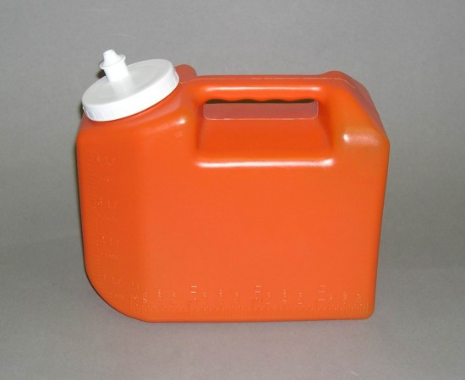
Measuring proteinuria
Quantitative measures
  Protein to creatinine ratio
  24 hour urine protein collection
www.therapak.com

Slide 113
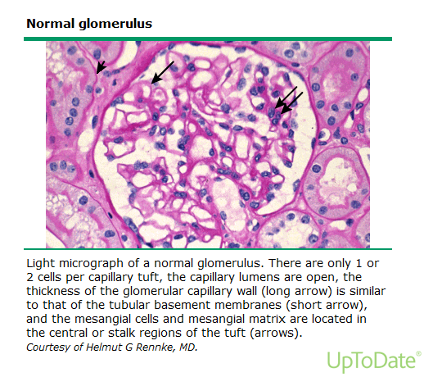
Normal protein excretion

Slide 114
Normal protein excretion
Urine protein to creatinine ratio:
  Child greater than 2 y: < 20 mg/mmol
  6-24 month old: < 50mg/mmol
24 hour urine protein:
  <100 mg/m²/d or <4 mg/m²/h

Slide 115
Normal protein excretion
Where is it coming from?
  Tubular epithelium
  Plasma protein
Notes:
divided evenly btw these 2
Tubular epithelium secretes protein (mainly Tamm-Horsfall protein)
Plasma proteins include albumin (40% of total), and LMW proteins - B2 microglobulin, amino acids

Slide 116
Normal protein excretion
Why is there not more protein in the urine?
  Composition of the glomerular capillary wall
  Reabsorption of the LMW proteins by the proximal tubule
Notes:
Glomerular capillary wall

Slide 117
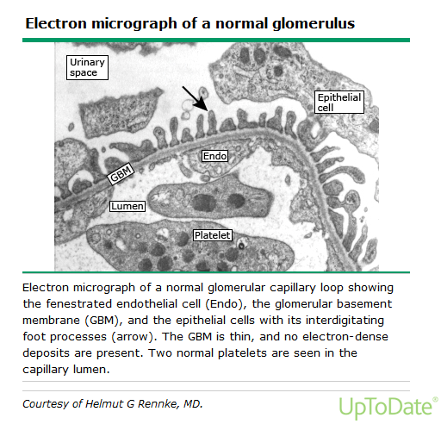
Abnormal protein excretion

Slide 118
Abnormal protein excretion
Abnormal
  Protein to creatinine ratio: >20 mg/mmol - 200 mg/mmol
  24 urine protein: >4 mg/m²/h - 40 mg/m²/h
Nephrotic
  Protein to creatinine ratio: > 200 mg/mmol
  24 urine protein: > 40 mg/m²/h

Slide 119
Proteinuria
Transient
Orthostatic
Persistent
Fever
Exercise
Seizure
Hypovolemia
Glomerular
Tubular
1º
2º
1º
2º
Minimal Change
Congenital nephrotic syndrome
Focal and segmental flomerulosclerosis
IgA
MPGN
Membranous
Alports
Acute PIGN
Diabetes
Lupus nephritis
Cystinosis
Dents disease
Wilsons disease
Lowes disease
ATN
Heavy metal poisoning
Tubulointerstitial disease
Obstructive uropathy
Notes:
Transient – most common cause of a positive urinary dipstick for protein
Associated with conditions that may alter renal hemodynamics such as acute febrile illness, vigorous exercise, or exposure to extreme cold.
Resolves spontaneously when condition is absent
Persistent
Marker for renal parenchymal disease
Needs follow-up

Slide 120
Reasons for increased protein
Glomerular proteinuria
  Increased filtration of macromolecules across glomerular caps
  Causes:
    Glomerular disease
    Fever
    Intensive exercise
    Orthostatic
Notes:
Common!
Increased filtration

Slide 121
Reasons for increased protein
Tubular proteinuria
  Decreased reabsorption of LMW proteins in the proximal tubule
  Often associated with other proximal tubular defects
  LMW proteins are not detected on dipstick (dipstick measures albumin)
Notes:
LMW ptns: beta-2-microglobulin, alpha-1-microglobulin, and retinol-binding protein
LMW – normally filtered across the glom then reabsorbed in PT
may be accompanied by other defects in PT function (glycosuria, RTA)
Not detected by screening dipstick

Slide 122
Reasons for increased protein
Overflow proteinuria
  Increased production of LMW proteins in the body leads to increased presence in the urine
  Not seen in kids
Notes:
surpasses PT’s reabsorptive capacity
Adults - e.g. multiple myeloma - too many IgG light chains
Not picked up on dipstick

Slide 123
Back to case 3
What is your approach to this child with this U/A:
Urinalysis:
Appearance: clear
Colour: yellow
Specific gravity: 1.015 (reference range: 1.003-1.030)
pH: 7.0 (reference range 5.0-8.0)
Leukocyte esterase: negative
Nitrite: negative
Protein: >3 (++++) g/L (reference range: neg-0.15)
Glucose: normal
Ketones: negative
Blood: negative Ery/uL
Urine Microscopy:
RBCs: 0-2 (reference range: 0-3 RBCs/hpf)
WBC: 0-2 (reference range: 0-8 WBCs/hpf)
Hyaline casts: 5-10 (reference range: 0-8 WBCs/hpf)

Slide 124
Approach to Asx child with mild proteinuria
Child with minimal protein on dip (1+ or 0.3 g/L)
  Repeat U/A
  Do a protein to creatinine ratio on 1st morning void
    Why?

Slide 125
Orthostatic proteinuria
AKA: postural proteinuria
Definition:
  Increased protein excretion in the upright position
  Returns to normal when the patient is supine
Epidemiology:
  Accounts for the majority of persistent proteinuria in children (60% of cases) and adolescents (75% of cases)
  Prevalence: 6%
Pathogenesis:
  Not well understood
Notes:
Pathogenesis:
Normal variant — Protein excretion normally increases with assumption of the upright posture from a recumbent position, although total protein excretion typically remains within the normal range [5]. Thus, orthostatic proteinuria may, in at least some cases, be an exaggeration of the normal response.
Subtle glomerular abnormality — In some patients with orthostatic proteinuria, renal biopsies have shown subtle glomerular changes, such as focal mesangial hypercellularity or basement membrane thickening [11-13]. These minor changes coupled with a glomerular hemodynamic abnormality could result in orthostatic proteinuria.
- Exaggerated hemodynamic response to the upright position — Increases in norepinephrine and angiotensin II when assuming an upright position may enhance glomerular permeability in susceptible individuals [14]. Angiotensin II release may also be associated with left renal vein entrapment (referred to as Nutcracker syndrome).
Because orthostatic proteinuria is benign and typically abates spontaneously with age, there is no clinical role for angiotensin blockade. (See 'Prognosis' below.)
- Left renal vein entrapment — Observations from several small case studies or reports suggest that entrapment of the left renal vein by the aorta and superior mesenteric artery (referred to as Nutcracker syndrome) plays a role in the pathogenesis of orthostatic proteinuria [15-18]:

Slide 126
Orthostatic proteinuria
Presentation:
  Incidental diagnosis
Labs:
  First morning void: normal protein to creatinine ratio (<20 mg/mmol)
  Upright sample (later in day): elevated
  Or 24h split sample (day – does not contain 1st am void; night-all urine from time of sleep and includes 1st am void)
Outcomes:
  No adverse effects on renal function
Management
  No follow-up required
Notes:
Outcomes:
- Patieents followed up to 50 years out – no adverse outcomes

Slide 127
Approach to Asx child with mild proteinuria
Repeat U/A shows blood or pyuria or protein to creatinine ratio >20 mg/mmol
    Proceed with further evaluation
    Hx: Hepatitis B/C, drugs, family hx
    PE: hypertension
    Investigations: Renal function, lytes, cholesterol, albumin
      May also do C3, C4, ANA, HIV, Hepatitis B/C
      Kidney US

Slide 128
Approach to Asx child with mild proteinuria
Repeat U/A shows blood or pyuria or protein to creatinine ratio >20 mg/mmol
    If all further evaluation is negative
      Repeat urinalysis x 2 and refer to Nephro if still abnormal
    If further eval shows something funny
      Refer to Nephro

Slide 129
Back to case 3
Repeat U/A: same
Urine protein to creatinine ratio: 1200 mg/mmol
What is going on here?
What do you want to do next?

Slide 130
Approach to child with nephrotic range proteinuria
U/A shows blood or pyuria or protein to creatinine ratio >200 mg/mmol
DDx of nephrotic range proteinuria in children:
  Minimal change disease
  Congenital nephrotic syndrome
  Membranoproliferative glomerulonephritis
  Focal and segmental glomerulosclerosis
  IgA nephropathy
  Membranous glomerulonephropathy
Notes:
Lytes – often see hyponatremia due to decreased free water excretion from hypovolemic stim of ADH
Renal function tests: may be elevated secondary to hypovolemia
Complement – MPGN, lupus, pign

Slide 131
Approach to child with nephrotic range proteinuria
U/A shows blood or pyuria or protein to creatinine ratio >200 mg/mmol
DDx of nephrotic range proteinuria in children:
Further evaluation of nephrotic range proteinuria should include
  BLOOD: Electrolytes, creatinine, urea, cholesterol, albumin and C3
  OTHER: depend on s/sx accompanying proteinuria but could include
    ANA, Hepatitis B/C serology, HIV
  RENAL BIOPSY: selective – consider if greater than 12 y old
Notes:
Lytes – often see hyponatremia due to decreased free water excretion from hypovolemic stim of ADH
Renal function tests: may be elevated secondary to hypovolemia
Complement – MPGN, lupus, pign

Slide 132
Question
Which of the following features are NOT associated with minimal change disease?
Absence of hypertension
Absence of hematuria
Age 10-15 years
Normal renal function
All of the above are features of minimal change disease

Slide 133
Minimal Change Disease
Clinical features (Protein LEAC)
  Nephrotic range proteinuria
  Hypoalbuminemia (Albumin < 30 g/L)
  Edema
  Hyperlipidemia
Pathogenesis
  Proteinuria
    Increased filtration of albumin across the glomerulus
    Loss of anionic charge without any structural change noted on light microscopy
    Electron microscopy: epithelial podocyte effacement
Notes:
e glomerular capillary wall. The latter consists of three components: the fenestrated endothelial cell, the glomerular basement membrane (GBM), and the epithelial cell foot processes. The pores between the foot processes are closed by a thin membrane called the slit diaphragm (picture 1).
The filtration of macromolecules across the glomerular capillary wall is normally restricted by two mechanisms: charge-selectivity and size-selectivity. The endothelial cells and the GBM have a net negative charge due to polyanions such as heparan sulfate proteoglycans. This creates a charge barrier to the filtration of large anions such as albumin. In comparison, circulating immunoglobulin G (IgG) is predominantly neutral or cationic, and its filtration is not limited by charge.

Slide 134
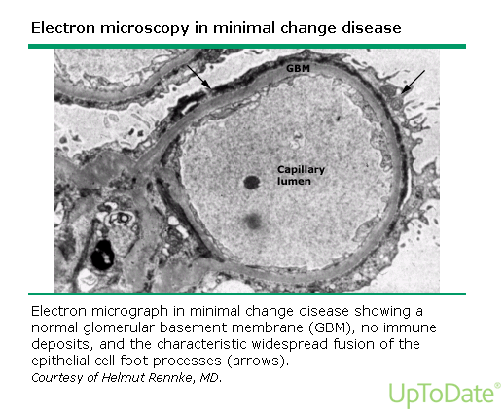
Minimal Change Disease
Notes:
- Diffuse foot process effacement

Slide 135
Minimal Change Disease
Epidemiology
  Most common form of childhood nephrotic syndrome (>90% of cases between 1 and 10 years, 50% of cases after 10 years of age)
Clinical presentation
  Usually a trigger
    URTI, insect bite, stressor, vaccination
  Edema
  May have s/sx of decreased effective circulating volume
Notes:
EDEMA
periorbital edema is noted first and is often misdiagnosed as a manifestation of allergy.
The edema is gravity dependent, and thus, over the day, periorbital edema decreases while edema of the lower extremities increases. In the reclining position, edema localizes to the back and sacral area.
Other dependent areas that can become edematous include the scrotum, penis, or labia. The affected edematous areas are white, soft, and pitting

Slide 136
Minimal Change Disease
Clinical presentation
  Key features on presentation that differentiate MCD from other forms of NS
    Age < 6 years of age
    Absence of hypertension
    Absence of microscopic hematuria
    Normal complement levels
    Normal renal function
Notes:
international Study of Kidney Disease in Children (ISKDC) study - Multivariate analysis demonstrated that clinical findings at presentation accurately differentiated children with MCD from those with other glomerular pathology.

Slide 137
Minimal Change Disease
Investigations
  Renal biopsy:
    If presentation is typical – a renal biopsy is not necessary and can proceed with treatment
    However, if child does not respond to therapy in a typical way, need to consider biopsy

Slide 138
Minimal Change Disease
Treatment
  Prednisone
    2 mg/kg/day for 6 weeks then 1.5 mg/kg/day on alternating days for 6 weeks
    80% of children will respond (protein to creatinine ratio returns to normal)
Notes:
Of the 80% that respond, most will respond within the first 2 weeks and 90% within the first 4 weeks

Slide 139
Minimal Change Disease
Outcomes
  Relapse: (80-90% of patients will experience one or more relapse)
    Treat with prednisone 2 mg/kg/d until u/a is neg or trace x 3 days then 1.5 mg/kg/d eod for 4 weeks
  Frequent relapse: (4 or more relapses per year)
    Stay on low-dose steroid
    Try second line agents: cyclophosphamide, cyclosporine, tacrolimus, MMF, rituximab
  Steroid-dependent: (relapse on tapering dose of steroid)
    Stay on low-dose steroid
    Try second line agents: cyclophosphamide, cyclosporine, tacrolimus, MMF, rituximab
  Steroid-resistant (no response after 8 weeks or pred)
    Renal biopsy
    ACE inhibitors
BOTTOM LINE: those that respond to steroids have better outcomes
Notes:
Of the 80% that respond, most will respond within the first 2 weeks and 90% within the first 4 weeks

Slide 140
Summary - proteinuria
Approach to pediatric proteinuria
  Repeat urinalysis to determine if the protein was transient
  Do a quantitative analysis (urine protein to creatinine ratio) on a first morning void – rule out orthostatic proteinuria
  Based on quantitative amount of proteinuria, proceed with either
    Repeat urinalysis and urine protein to creatinine ratio on 2 occasions
    Further labs
    Referral to pediatric nephrologist
Minimal change disease
  Most common cause of nephrotic range proteinuria in children
  Usually steroid responsive
  If presents with typical features and is steroid responsive, does not require biopsy

Slide 141
Hypertension

Slide 142
Hypertension
Either systolic and/or diastolic BP ≥95th percentile measured upon three or more occasions
Stage 1: SBP and/or DBP between the 95th percentile and 5 mmHg above the 99th percentile
Stage 2: SBP and/or DBP ≥99th percentile plus 5 mmHg.

Slide 143
Urgency vs Emergency
Emergency
A severe symptomatic elevation in BP with evidence of acute target organ damage
    Brain (seizures, increased intracranial pressure)
    Kidneys (renal insufficiency)
    Eyes (papilledema, retinal hemorrhages, exudates)
    Heart (heart failure)
Notes:
the absolute degree of BP elevation is less important than whether end organ symptoms and/or damage is present
hypertensive emergencies in children usually manifest as hypertensive encephalopathy
Needs emergent IV treatment!

Slide 144
Urgency vs Emergency
Urgency
A severe elevation in BP without sx or evidence of acute target organ damage
    Brain (seizures, increased intracranial pressure)
    Kidneys (renal insufficiency)
    Eyes (papilledema, retinal hemorrhages, exudates)
    Heart (heart failure)

Slide 145
Treatment for Emergencies
Lower BP promptly by up to 25% in the first 8h
Use labetalol IV infusion or bolus
Other choices include hydralazine, esmolol
Notes:
NOTE: no RCTs in peds. Evidence is from observational trials
Rapid lowering of BP to less than 25 percent of maximum BP may lead to permanent end organ damage due to hypertension-induced abnormalities of autoregulation

Slide 146
Treatment for urgencies
Urgent evaluation
If urgency arises from
  An acute process (e.g. GN) with rapid change in MAP,
    consider prompt IV Rx
  A chronic process (CKD) where BP has increased gradually over time
    consider oral Rx with BP lowering over several days

Slide 147
Treatment for urgencies
Oral meds
UTD says nifedipine is no longer used
Clonidine
Notes:
nifedipine: difficulties with dosing, prolonged and unpredictable action, risk of hypotension, and rebound hypertension
Clonidine: A centrally-acting alpha 2-adrenergic agonist, clonidine reduces blood pressure by reducing cerebral sympathetic output. It has a relatively rapid onset of effect, approximately 15 to 30 minutes following oral administration [18], making it attractive for use in management of acute hypertension

Slide 148
Now for the rare stuff that the Royal College loves most

Slide 149
Barrter and Gitelman Syndrome
Notes:
Inherited salt losing tubulopathies

Slide 150
Bartter Syndrome

Slide 151
Bartter Syndrome
Looks like chronic furosemide use
Why?
  Bartter’s genetic defect results in decreased activity in one of several electrolyte transporters in the loop of Henle’s thick ascending limb
  Furosemide inhibits salt absorption in the loop of Henle’s thick ascending limb
So what should you see?
Notes:
Loop diuretics compete for the chloride site on the Na-K-2Cl carrier in the luminal membrane of the thick ascending limb
What should you see in terms of volume status? Urine output? Srum lytes and urine lytes?

Slide 152
Bartter Syndrome
Volume problems
  Impaired NaCl absorption
  Polyuria and polydipsia
  Volume depletion
  Activation of RAAS
  Lowish blood pressure
Notes:
- Polyuria and polydipsia from decreased urinary concentrating ability

Slide 153
Bartter Syndrome
Serum electrolyte problems
  Hypokalemia
  Metabolic alkalosis
  Normal or mildly decreased Mg
Urine lytes
  Normal to increased urine Ca
Notes:
Low K: combo of secondary hyperaldosternoism and increased distal flow and sodium delivery increases the potassium and hydrogen secretion
Reabsorption of calcium and magnesium in the loop of Henle is primarily passive (driven by electrochemical gradient created by NaCl transport) via paracellular pathway
Thus less NaCl reabsorbed = less Ca absorbed

Slide 154
Bartter Syndrome
Other
  Growth and mental retardation
  Depending on the lesion, can present in prenatal/infancy period or later in life
Genetics
  AR
Prevalence
  1/1,000,000

Slide 155
Gittelman Syndrome

Slide 156
Gitelman Syndrome
Looks like chronic thiazide use
Why?
  Gittelman’s genetic defect results in decreased activity in one of several electrolyte transporters in the distal tubule
  Thiazides inhibit salt absorption in the distal tubule
Notes:
Distal tubule responsible for less sodium reabsorption than loop, thus limited diuresis (and natriuresis)
Thiazides inhibit sodium reabsorption by competing for the chloride site on the Na-Cl cotransporter (NCCT)
What should you see in terms of volume status? Urine output? Serum lytes and urine lytes?

Slide 157
Gitelman Syndrome
Volume status
  Mild volume depletion
  Activation of RAAS
  Normal blood pressure (usually)

Slide 158
Gitelman Syndrome
Serum lytes
  Hypokalemia
  Metabolic alkalosis
  Hypomagnesemia
Urine lytes
  Hypocalciuria
Notes:
Distal tubule is the major site for active Ca reabsorption. Here, reabsorption is independent of Na transport (unlike in loop)
Hypocalciuria is maintained by the increase in PT NaCl reabsorption whoch causes ca reabsorption in PT

Slide 159
Gitelman Syndrome
Other
  Usually diagnosed later in life
Genetics
  AR
Prevalence
  1/40,000

Slide 160
Similarities
Genetics
  AR
Volume status
  Impaired NaCl reabsorption leading to
    Volume contraction
    Hyperreninemia (from volume contraction)
    Hyperaldosteronism (from high renin)
  No hypertension
Metabolic abnormalities
  Hypokalemia
  Metabolic alkalosis
Notes:
Aldoseterone and increased distal Na delivery lead to potassium secretion and hydrogen secretion in distal tubule

Slide 161
Comparison chart
 | Bartter | Gitelman
Drug | Furosemide | Thiazide
Volume | Mild-mod depletion | Mild depletion
BP | Low | Normal
Serum lytes | Low potassium, met alk N to low Mg | Low potassium, met alk Low Mg
Urine | N to high Ca | Low Ca
Presents | Infancy to early years | Adult
Prevalence | Very rare (1/1,000,000) | Rar-ish (1/40,000)

Slide 162
RTA

Slide 163
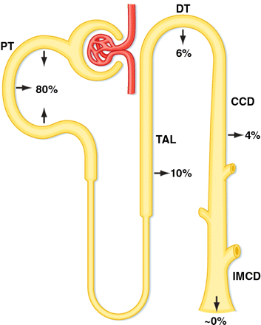
Renal handling of bicarbonate
Assuming
  GFR of 180 L/day and [HCO3] 24 mEq/L
  Filtered load HCO3 is 4.3 Eq/day
Koeppen MB. 2009. Adv Physiol Educ 33(4): 275-81

Slide 164
Overall problem in RTAs
Proximal RTA
Too little base
  Reduction in proximal bicarbonate reabsorptive capacity
  Bicarbonate is “wasted” in the urine
  Wasting continues until serum bicarbonate has fallen so low such that all the bicarbonate that is filtered through the glomerulus and into the
Too much acid
  Impaired distal acid secretion
  Progressive retention of hydrogen ions leads to decrease in serum HCO3 and abnormally high urine pH (greater than 5.5)
Distal RTA

Slide 165
Proximal RTAs
Isolated
Fanconi’s
Inherited
Acquired
Genetic
Transient
1. Neonates
- Mitochondrial
- Galactosemia
- Tyrosinemia
2. Infants
- Cystinosis
- Lowes
3. Childood
- Dent’s
- Cystiniosis
- Wilson’s
Meds
Renal disease
Meds
1. Anti-cancer
- Ifosfamide
2. Abx
- Aminoglycosides
3. Anti-retrovirals
- Cidofovir
1. Tubulo-interstitial nephritis
2. Tx
3. Membranous nephopathy
Carbonic anhydrase inhibitors
-topiromate
- acetazolamide
Heavy Metals
Lead
Cadmium
Mercury
Notes:
Isolated - rare

Slide 166
Proximal RTAs
Major features
  Degree of acidosis is self-limited
    HCO3 usually 14-20 (compare to <10 in distal RTA)
  Hypokalemia
    Decreased proximal sodium reabsorption means increased distal sodium reabsorption (when sodium goes in, potassium is secreted thus potassium falls)
  When HCO3 is given
      No longer steady state.
      Will have HCO3 loss – thus urine pH will increase
      Will have increased distal delivery of Na (with HCO3) and water. Thus more Na reabsorbed and resulting worsening HYPOKALEMIA

Slide 167
Distal RTAs
Major features
  Inability to excrete daily acid load
    HCO3 usually <10
    Urine pH is 5.5 or higher (i.e. not acidic when you would expect it to be with acidemia)
  Hypokalemia
    Mutation in distal proton pump means no H secreted into lumen
    Sodium moving into principal cell creates negative charge
    K moves out down electroneg gradient
  When HCO3 is given
    HCO3 reaches distal tubule and improves pH thus less K out
    Improved HYPOKALEMIA

Slide 168
Distal RTAs
Genetic
Acquired
H-ATPase defect
Cl-HCO3 exchanger defect
Meds
Renal disease
-2 forms – both AR
- Present in infancy with poor growth and severe met acid
Amphotericin
Ifosfamide
Lithium
Toluene
- Obstructive uropathy
- MSK
- Renal transplant rejection
Autoimmue disease
Hypercalciuric conditions
- HyperPTHism
- Vit D intox
Sjogrens
SLE
RA
AI hepatitis
Notes:
Isolated - rare

Slide 169
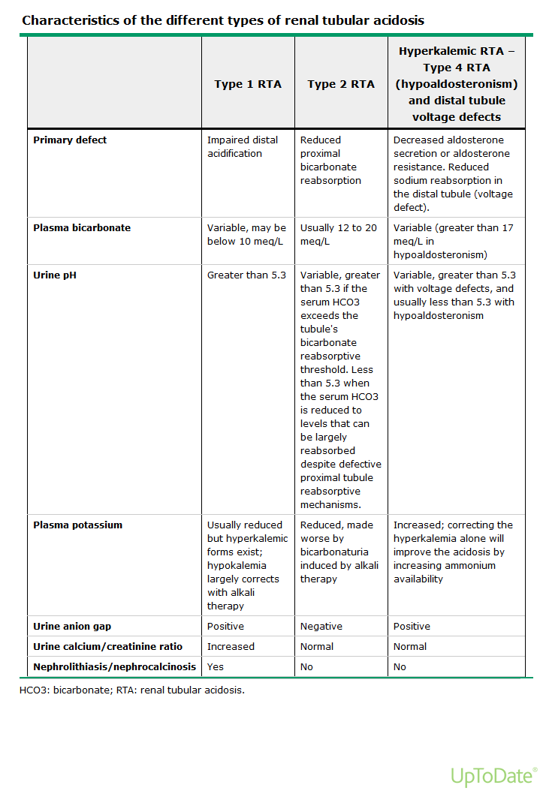

Slide 170
Urine anion gap
Difference between the positive charges and negative charges in urine
  UAG = Urine (Na + K –Cl)
Usual state: more Na and K in excreted than Cl-
  POSITIVE charge
With diarrhea: loss of bicarbonate salts in the stool (NaHCO3 and KHCO3)
  Decreased Na and K in urine but Cl unchanged
  NEGATIVE charge
Metabolic acidosis: want to excrete H+
  H+ is excreted as ammonium (NH3+H →NH4+)
  Ammonium travels with Cl-
  Thus should see NEGATIVE charge
In patients with met acidosis from impaired H excretion
  Will have same as usual state without increase H excretion
  POSITIVE charge

