Slide 1
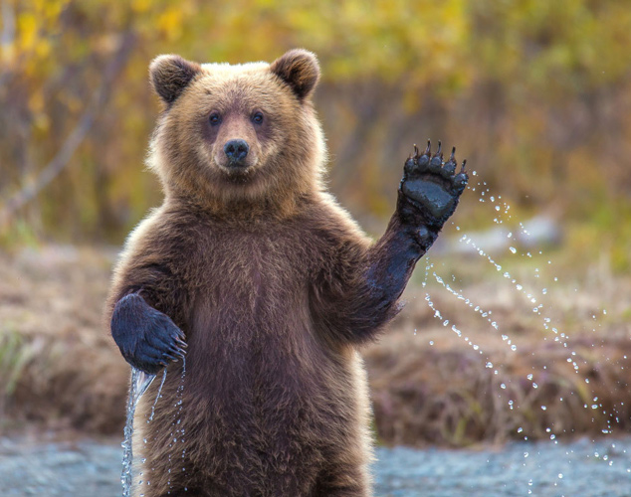
Welcome!
Oki (Blackfoot)
Tansi (Cree)
Aaniin (Ojibwe)
Bienvenue (French)
Binvnu (Michif)
Tunngasugitsi (Inuktitut)
Amboshstich (Stoney Nakoda)
Dadanast’ada (Tsuut’ina)
Notes:
Oki – Hello, welcome
Tansi – Hello, how are you?
Aaniin (ah-nee) – Hello, welcome
Bienvenu - Welcome
Binvnu - Welcome
Tunngasugitsi (Too-nga-su-geet-see) – Welcome
Amboshstich – Hi, how are things?
Dadanast’ada – Hello to a large group
Introduce ourselves. Have each participant introduce themselves – name, role, where they work, or however they’d like to introduce themselves.

Slide 2
Current Cultural Competency education- AHS
Indigenous Awareness and sensitivity workshop 3.5 hours
  VIA Zoom – registration on MyLearningLink: https://mylearninglink.albertahealthservices.ca/elearning/bins/index.asp
    Search – Indigenous
Indigenous Awareness and sensitivity e-learning modules
  8 e-learning modules
  https://mylearninglink.albertahealthservices.ca/elearning/bins/index.asp
Indigenous health resources
https://insite.albertahealthservices.ca/ihp/Page9219.aspx
  Telehealth series and resources tabs to access
NEW Curriculum for group learning opportunities
  Request for these presentations by contacting Indigenous.Education@ahs.ca
  Allyship, Two-eyed seeing, Land Acknowledgements, Indigenous Social determinants of health

Slide 3
Calgary Zone Indigenous resources
Indigenous Protocol guide
  https://insite.albertahealthservices.ca/Main/assets/tms/pp/tms-pp-indigenous-traditional-protocols.pdf#search=Indigenous%20health%20protocol
Indigenous Peoples and Communities in Alberta
  https://insite.albertahealthservices.ca/Main/assets/tms/ihp/tms-ihp-booklet.pdf#search=indigenous%20mental%20health
Calgary Zone Indigenous Action Plan – Digital Stories – 8 stories
https://www.albertahealthservices.ca/about/Page13771.aspx

Slide 4

O'tsisina - Joe's Family Story

Slide 5
Calgary Zone Indigenous services
Indigenous Hospital Liaisons/Traditional Wellness Coordinators (Cultural/spiritual liaisons)
  https://www.albertahealthservices.ca/findhealth/Service.aspx?serviceAtFacilityId=1126413
Elbow River Healing Lodge/ Indigenous Mental Health
  https://www.youtube.com/watch?v=mX2sL48SSdA&list=PLi1tOF1I5ZoUvse4nEljWZCVGIzk8U8S-&index=8
  Located in Sheldon M. Chumir

Slide 6
Indigenous Hospital Liaison
What does an Indigenous Hospital Liaison (IHL) do?
An IHL can:
• Help you and your family feel comfortable in the hospital
• Make referrals
• Advocate for you and your family
• Help plan and support your discharge from the hospital
• Talk to healthcare providers about Indigenous cultural, spiritual and practices
• Help arrange Indigenous spiritual practices and ceremonies.
Alberta Health Services has a policy to allow spiritual ceremonies. Ask your healthcare provider, IHL, or Spiritual Care Services for more information.
Do I need a referral to see the IHL?
You can ask to see the IHL yourself or you can be referred by:
• Any healthcare provider
• A family member or support person

Slide 7
Contact information
Provincial Indigenous Wellness Core – Calgary Zone – Senior Advisor
  Shelley Goforth – shelley.Goforth@albertahealthservices.ca
Provincial Indigenous Wellness Core – Cultural Competency – Senior Advisor
  Simon Ross – simon.ross@albertahealthservices.ca
Indigenous Cultural Competency – Education requests
  Indigenous.Education@albertahealthservices.ca

